Slide 1


Lesson 4 School rules
UNIT 1

Slide 2
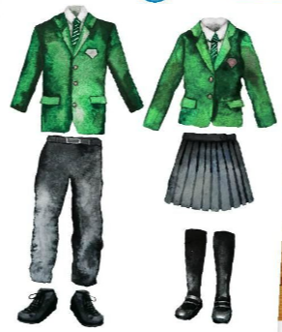
What can you see in the picture?
School uniforms.
Do you wear school uniforms? Would you like to? Why?
Read the words listed below. Which clothing items are worn by boys and which by girls?
SHIRTS TROUSERS SHOES
A TIE SKIRTS SWEATSHIRTS
BLAZERS (JACKETS)

Slide 3
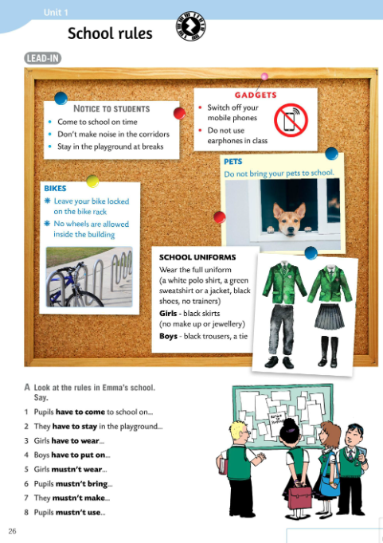
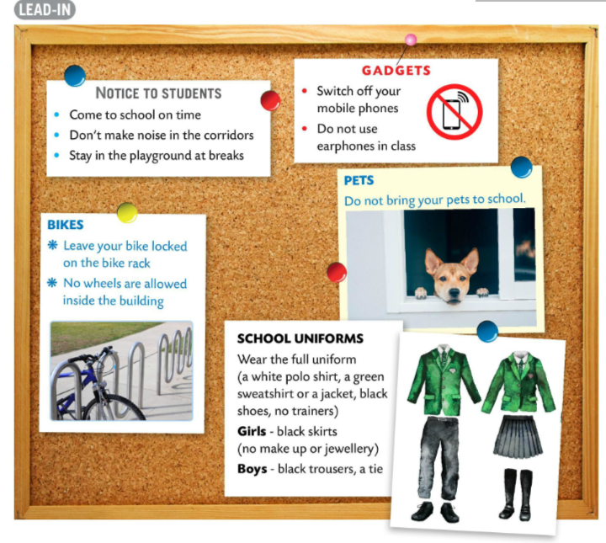
Look at the rules in Emma’s school. Read them and think about rules in your school.
Write translations of the following words:
notice – obavijest
corridor – hodnik
break – pauza
gadget – uređaj
bike rack – stalak/postolje za bicikle
wheels – kotači

Slide 4
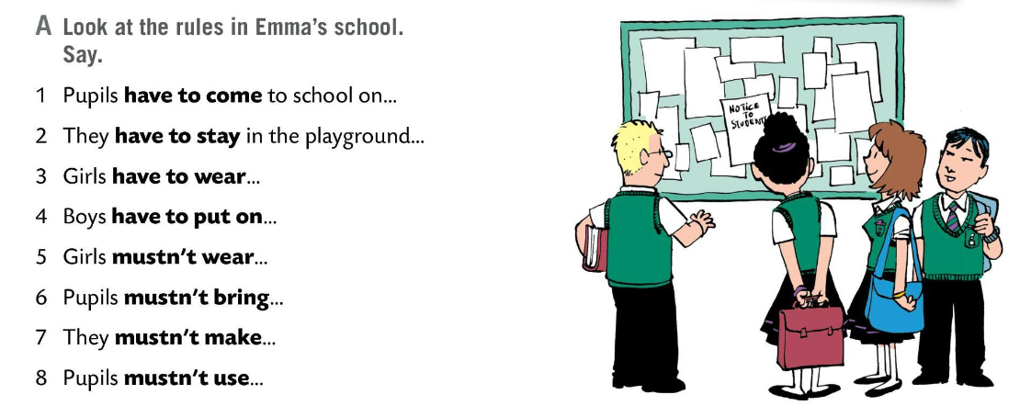
Look at the rules and finish the sentences in Task A.
Check.
1 Pupils have to come to school on time.
2 They have to stay in the playground during breaks.
3 Girls have to wear a white shirt, a green sweatshirt or a jacket, a black skirt, and black shoes.
4 Boys have to put on a white shirt, a green sweatshirt or a jacket, a tie, black trousers, and black shoes.
5 Girls mustn’t wear a mini skirt, make up, or jewellery.
6 Pupils mustn’t bring their pets to school.
7 They mustn’t make noise in the corridors.
8 Pupils mustn’t use mobile phones or earphones in class.

Slide 5
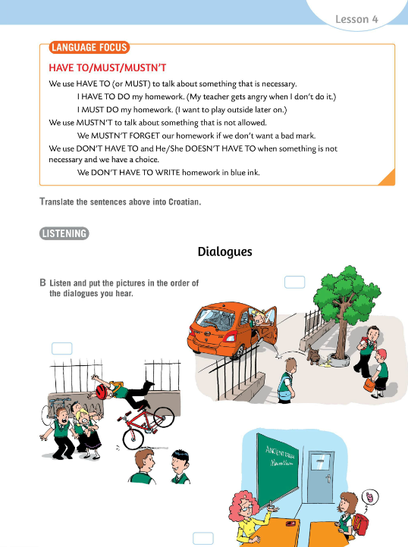
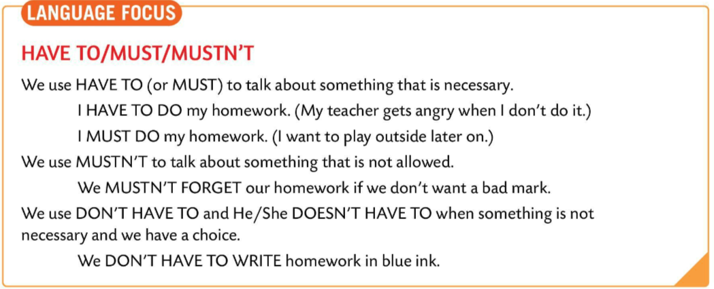
LANGUAGE FOCUS
We use HAVE TO (or MUST) to talk about something that is necessary.
Koristimo HAVE TO (ili MUST) kada govorimo o nečemu što je nužno, tj. neophodno učiniti.
I HAVE TO DO my homework.
(My teacher gets angry when I don’t do it.)
Moram napisati domaću zadaću.
(Moja učiteljica je ljuta kada ju ne napravim.)
I MUST DO my homework. (I want to play outside later on.)
Moram napisati domaću zadaću. (Želim se igrati vani kasnije.)

Slide 6
We use MUSTN’T to talk about something that is not allowed.
Koristimo MUSTN’T kada govorimo o nečemu što nije dozvoljeno činiti, tj. kada je nešto zabranjeno.
We MUSTN’T FORGET our homework if we don’t want a bad mark.
Ne smijemo zaboraviti domaću zadaću ako ne želimo dobiti lošu ocjenu.

Slide 7
We use DON’T HAVE TO / DOESN’T HAVE TO when something is not necessary and we have a choice.
DON’T HAVE TO / DOESN’T HAVE TO koristimo kada nešto nije nužno učiniti te imamo mogućnost odabira.
We DON’T HAVE TO DO homework in blue ink.
Ne moramo pisati domaću zadaću plavom kemijskom olovkom.

Slide 8
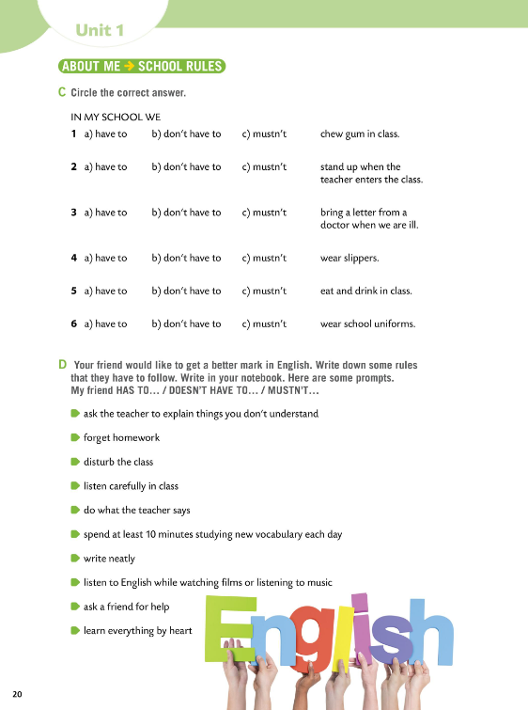

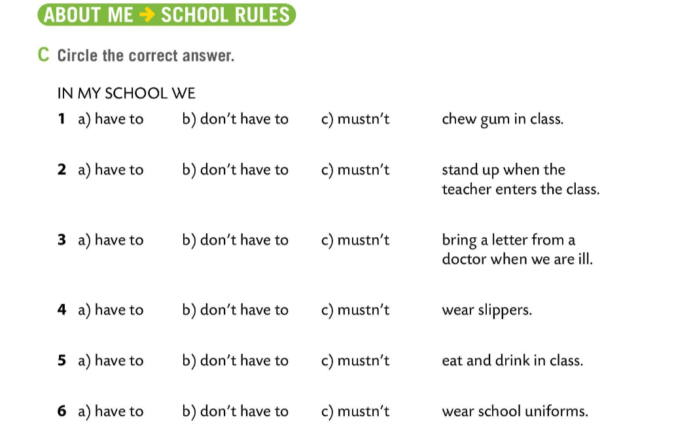
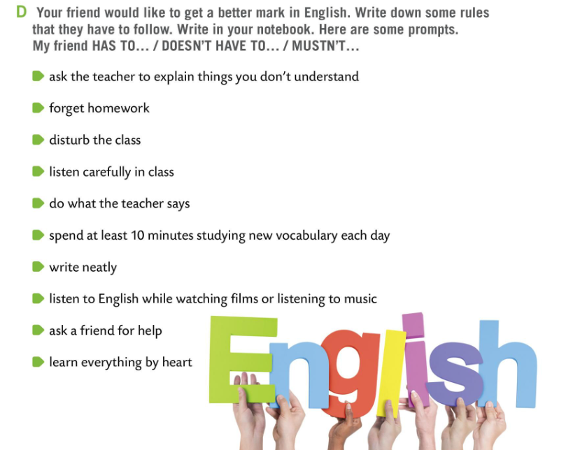
Workbook, page 20.
Circle the correct answer in Task C.
Check answers with the teacher.
Write rules abour effective language learning. Use suggetions from task D.
Check answers with the teacher.

Slide 9
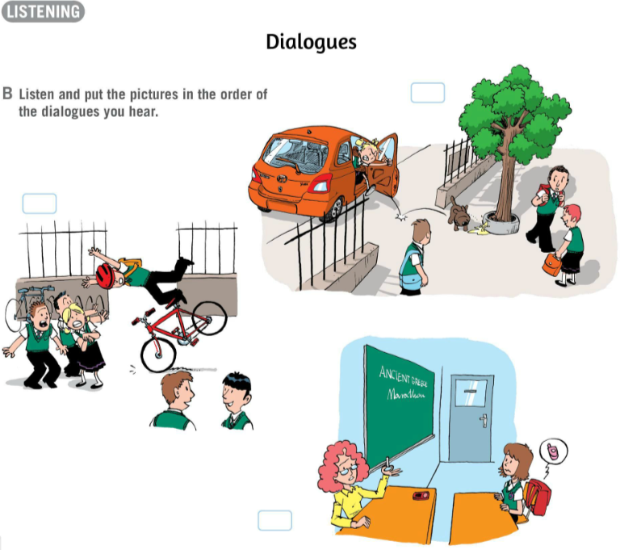

Listen to the recordings twice and put the pictures in Task B in order of the dialogues you hear.
Listen and put the number next to the corresponding illustration.
Dialogue 1
Dialogue 2
Dialogue 3
1
3
2
Check.

Slide 10
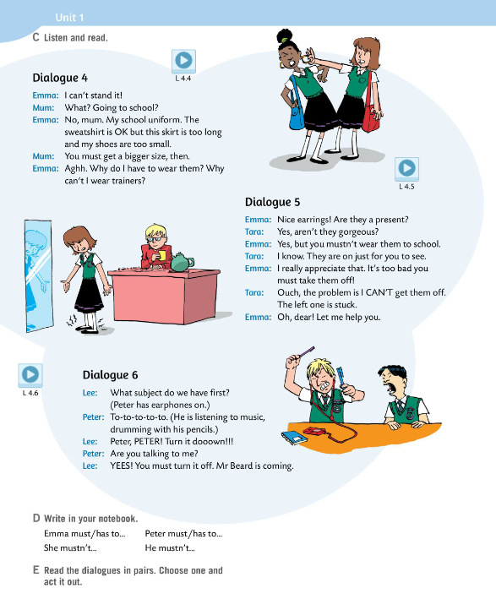
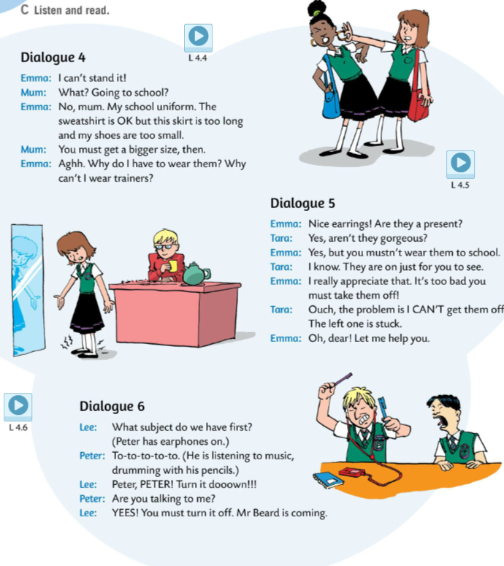
Listen to three more dialogues in Task C.
Dialogue 4
Dialogue 5
Dialogue 6
Read the dialogues 4, 5, & 6.
Write the new words in your notebooks.
Translate with the help of the dictionary at the end of the book.

Slide 11
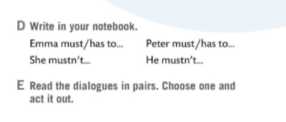
Finish the sentences from Task D.
Check.
Emma must get a bigger shoe size. Emma has to wear her school uniform.
She mustn’t wear earrings to school.
Peter must/has to turn off the music.
He mustn’t have earphones in the classroom.
Read the dialogues in pairs. Choose one dialoge and act it out.

Slide 12
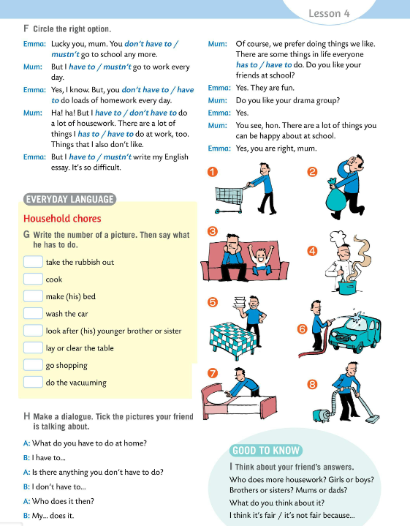
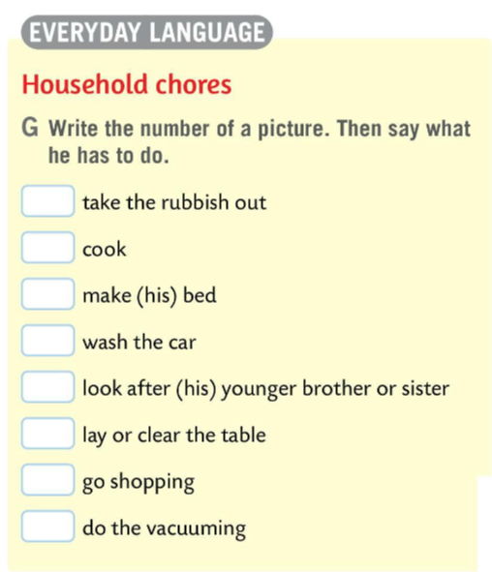
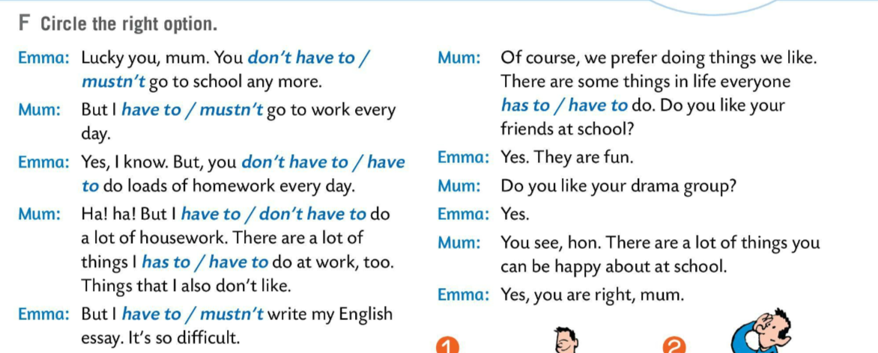

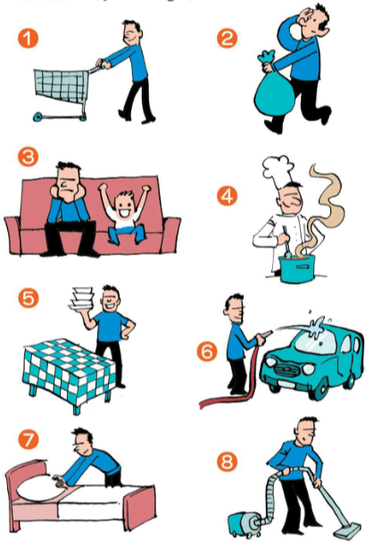
Read the dialogue in Task F and circle the right option.
Check.
2
HOUSEHOLD CHORES
Write the translations.
iznijeti smeće
4
kuhati
7
napraviti krevet
6
oprati auto
3
Task G. Write the number of a picture in front of the correct chore. Then say what he has to do.
čuvati mlađeg brata ili sestru
5
postaviti ili počistiti stol
1
ići u kupovinu
8
usisati
Check.

Slide 13
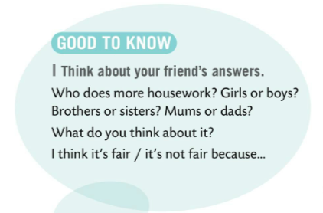
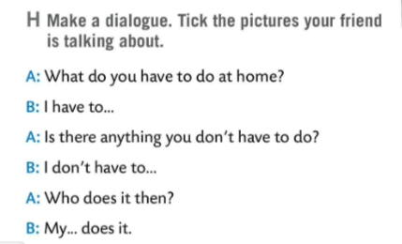
Make a dialogue using the sentences in task H. Tick the pictures your friend is talking about.
GOOD TO KNOW
Answer the questions.

Slide 14
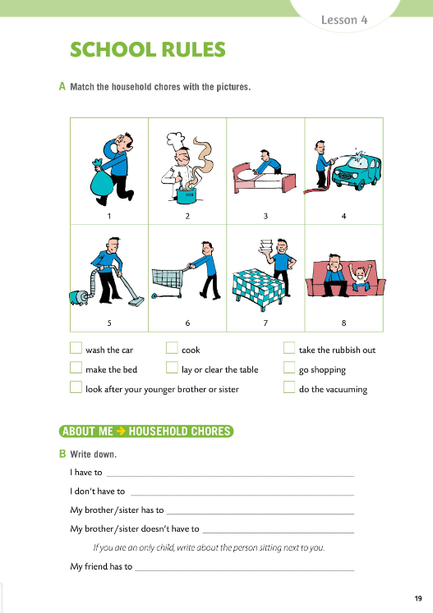
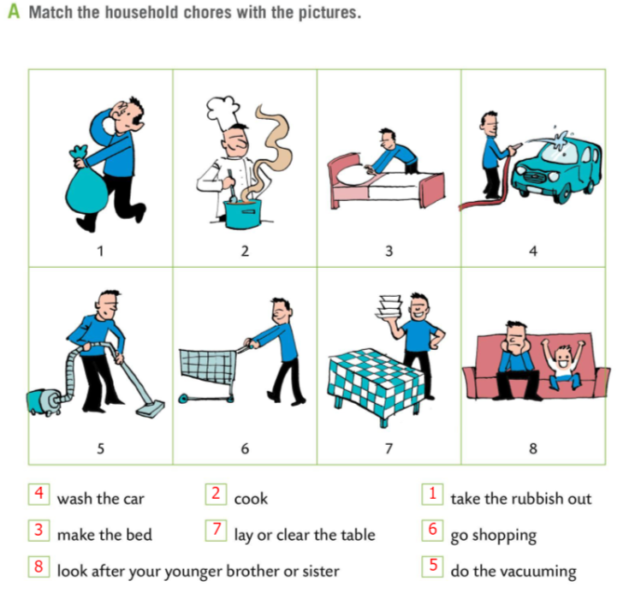
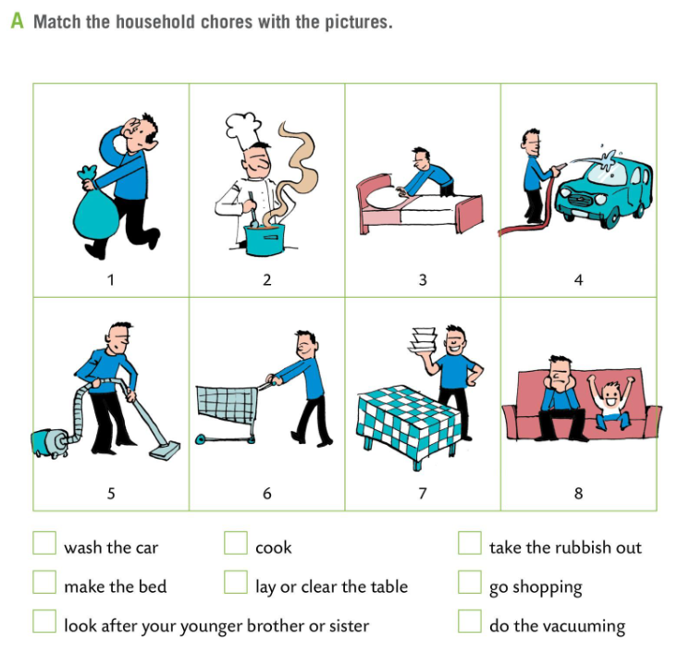
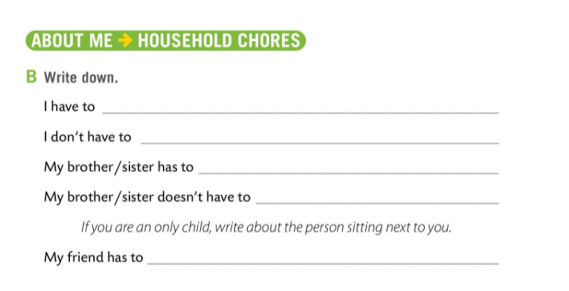
Workbook, page 19.
Match the household chores with the pictures in Task A.
Check.
What about you? Write down which household chores you have to do.

Slide 15
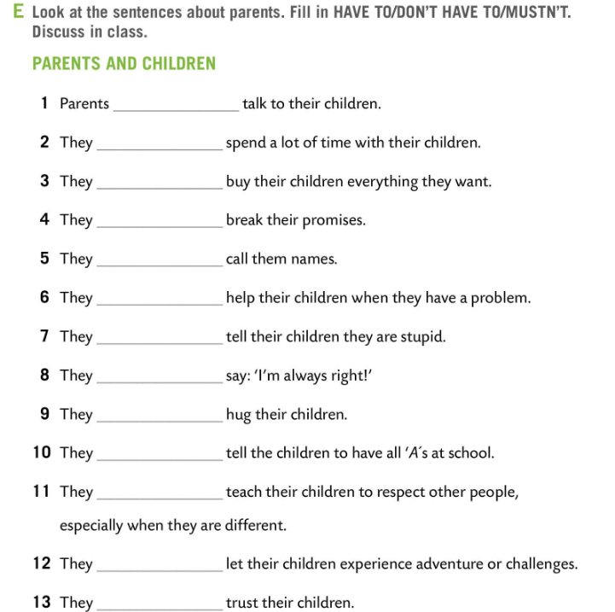
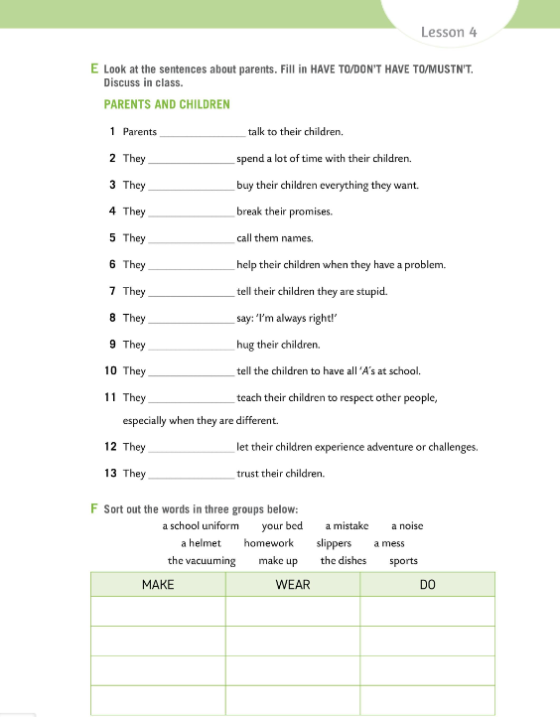
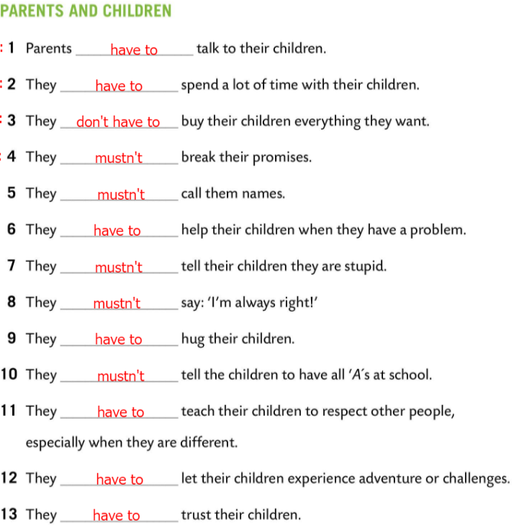
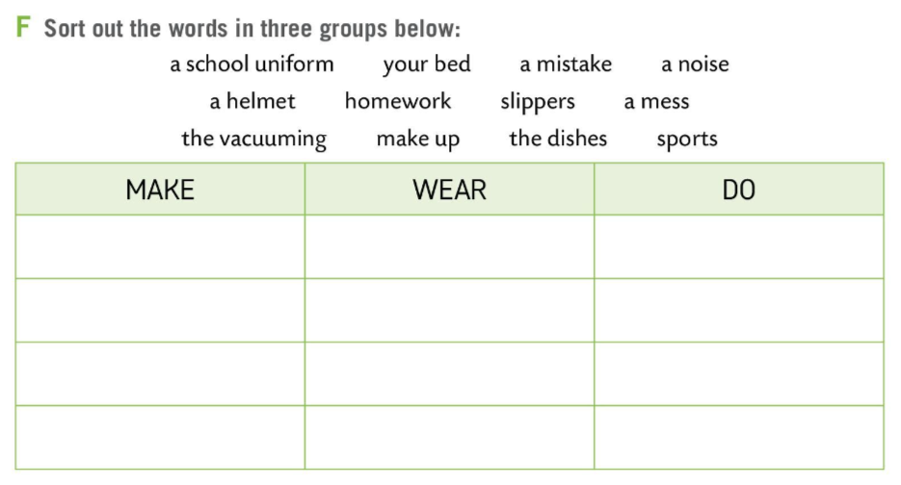
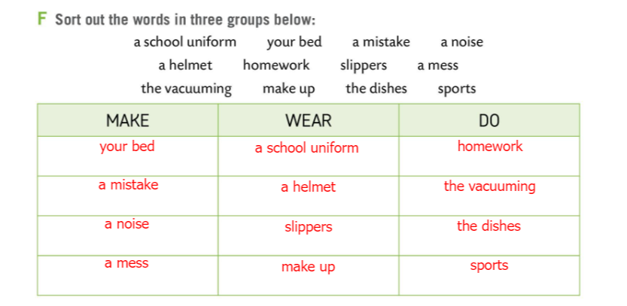
Workbook, page 21.
Task E Fill the sentences with
HAVE TO/DON’T HAVE TO/MUSN’T.
Check possible answers. Do your answers differ?
Do Task F. Sort out the words in the table.
Check.

